Slide 1

DSBA 6100 Phase 2 Group Project Presentation
Xinhui cai, Micajah Jones,
menghang li, Shuhua (Jessica) yin

Slide 2
Key Points
Goal: Streamlining the claims process to minimize inefficiencies
Strategic objectives
Expediting claims that are likely to score critically for processing time
→ Increased attention to updates and deadlines for claims filed on Friday, and claims involving multiple body parts
Proactively and efficiently allocating resources
→ Increasing reserve requirements for claims involving multiple body parts, male claimants, and claims filed on Monday
Add attributes to strengthen our predictive capability
→ Ask client company to begin collecting data on expected recovery time

Slide 3
Hypotheses on Collected Payment
Body Part Region
Which part(s) are significant for the model
Claimant Age
Younger/older impact physicals and thus total payment
Claimant Type: Indemnity, Medical Report Only
Total Recovery
Total Incurred Cost = Indemnity + Total Reserves + Other Paid-Total Recovery
Processing Time*
Recovery Period*
Claimant Open Day Week*
* : new variables which will be introduced in a separate slide

Slide 4
Hypotheses on Processing Time
Body Part Region
Total Reserve
Fatality
Processing time → critical if injury is fatal
Collected Payment (Total Incurred Cost)
Claimant Age
Claimant Type
Gender
Recovery Period*
Claimant Open Day Week*

Slide 5
New Variables
Claim Open Day Week
date → days of the week (Monday to Sunday): 1 to 7
Possibility: Mondays receive higher critical total payment & processing time than other days of the week
Processing Time/Date Difference
Time difference between Claimant Open Date & Claimant Closed Date
Recovery Period
Time between Incident Date & Return to Work Date
How long do employees take to recover from injuries?

Slide 6
Model Comparison – Linear Regression
Scenario of Linear Regression Model:
Input variables:
Age, Gender, Body Part Region, Fatality, Recovery Period, ClaimOpenDayOn Week, Claimant Type, Processing Time (only in payment model), Total Incurred Cost (only in Processing Time model)
Set up dummy variables for categorical variables, such as Gender, Body Part Region
Outcome variables:
Processing Time, Total Incurred Cost (Payment) –they are not in the same model

Slide 7
Model Comparison – Linear Regression
Pros
Statistically significant variables
Coefficients estimates
Cons
Only accepts numeric outcome variables
No toleration on missing values (highly demanding in data wrangling)
Too many assumptions: linear relationship, no multicollinearity

Slide 8
Model Comparison – Decision Tree
Scenario of Decision Tree
Classification technique to group data into categories or find out the decision tree
Input Variables
Age, Gender, Body Part Region, Fatality, Recovery Period, ClaimOpenDayOn Week, Claimant Types, and the variables with missing values (Weekly Wage)
Categorizing continuous variables (Age, Recovery Period) are easy for splitting
Outcome Variables
Binary processing time (12 months)/Total Incurred Cost ($437)

Slide 9
Model Comparison – Decision Tree
Pros
Clearly shows splits and variable selection process
Regardless missing values
Accept categorical variables (without setting dummy variables)
Cons
Overfitting problem (esp. in business domain, not enough validation data to prune the model)
No coefficient estimates (quantitative predictions in business domain)

Slide 10
Model Comparison – LOGIT
Scenario of Logistic Regression Model:
Predicting the probability of event happening on the past data
Input Variables:
Age, Gender, Body Part Region, Fatality, Recovery Period, ClaimantOpenDayOn Week, Claimant Type, Processing Time (only in payment model), and Total Incurred Cost (only in processing time model)
Outcome Variable:
Binary processing time/ total incurred cost

Slide 11
Model Comparison – LOGIT
Pros:
Coefficient estimates
Odds ratio indicates strength each variable associated to outcome variable
Cons:
Only works for binary outcome
Based on linear assumption, not suitable for non-linear problem
No toleration to missing value
Overfitting issue and sensitive to multicollinearity between variable

Slide 12
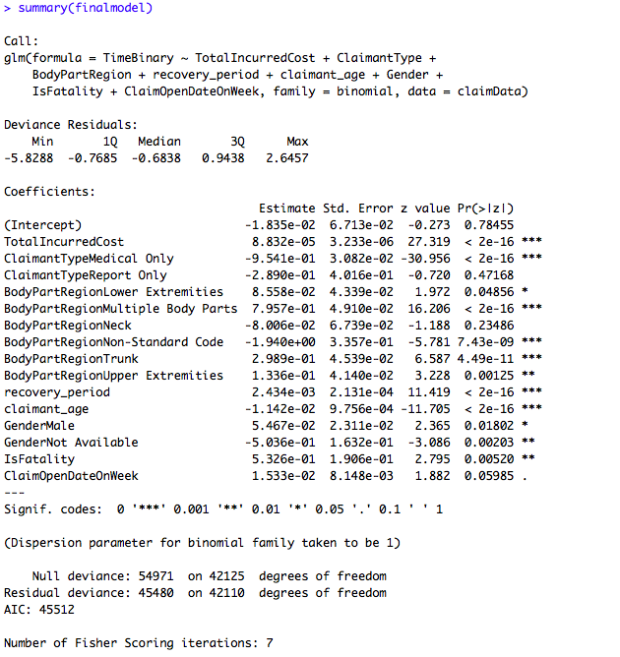
LOGIT – Processing Time
Body Part Region
Control group: Head
Multiple Body Parts: 69%↑
Trunk: 57%↑
Upper Extremities: 53%↑
Lower Extremities: 52.13%↑
Fatality: 63%↑
Claimant Type
Control group: Indemnity
Medical Only: 27.8%↓

Slide 13
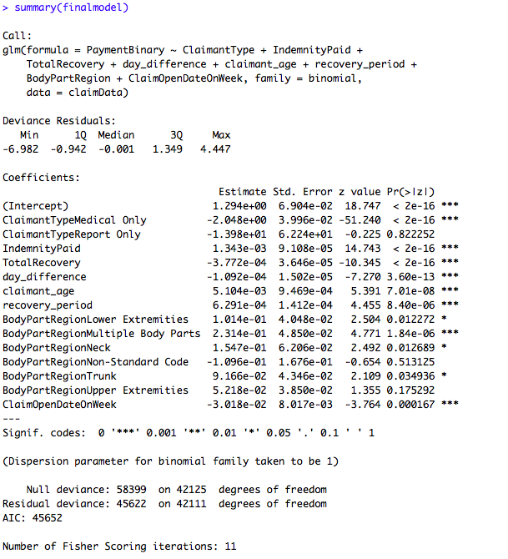
LOGIT – Payment
Body Part Region
Control group: Head
Multiple Body Parts: 55.76%↑
Neck: 53.86%↑
Lower Extremities: 52.53%↑
Trunk: 52.29%↑
Claim Open Day on Week: 49.25%↑
Claimant Type
Control group: Indemnity
Medical Only: 11.4%↑

Slide 14
Recommendations
What is in the claims company’s control?
Cannot directly reduce total incurred costs
Cannot reduce the time to process in every case. E.g. workplace death
Can set reserve requirements
Can choose to change from a FIFO system to a LIFO
Technological overhead costs. E.g. administrative cost
“Increased attention to updates and deadlines for claims filed on Friday, and claims involving multiple body parts”
“Increasing reserve requirements for claims involving multiple body parts, male claimants, and claims filed on Monday”
“Ask client company to begin collecting data on expected recovery time”

